Slide 1
GRIDAPPSD updates

Slide 2


Pause, resume, stop

Slide 3

Getting weather data

Slide 4
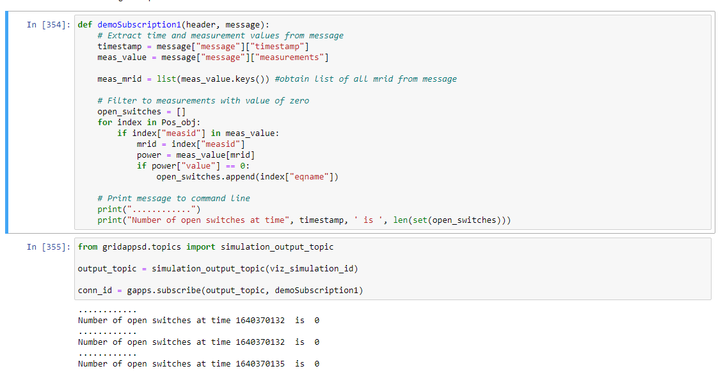
Getting measurements – measuring switch states

Slide 5

Getting the specific switch

Slide 6

Changing switch states with inputs

Slide 7
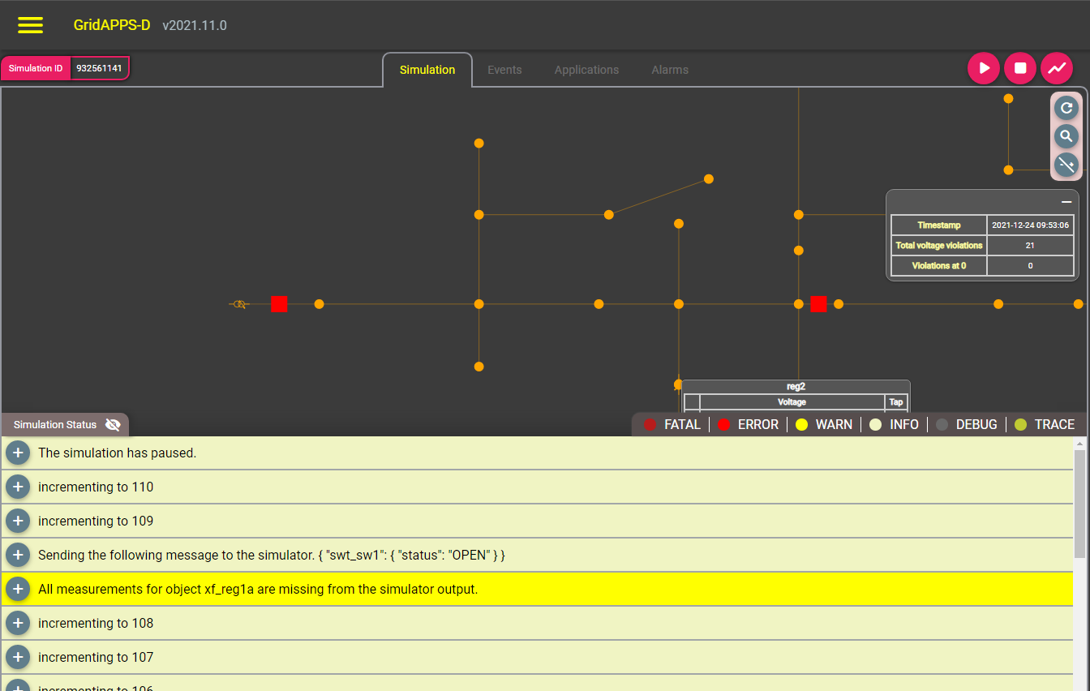
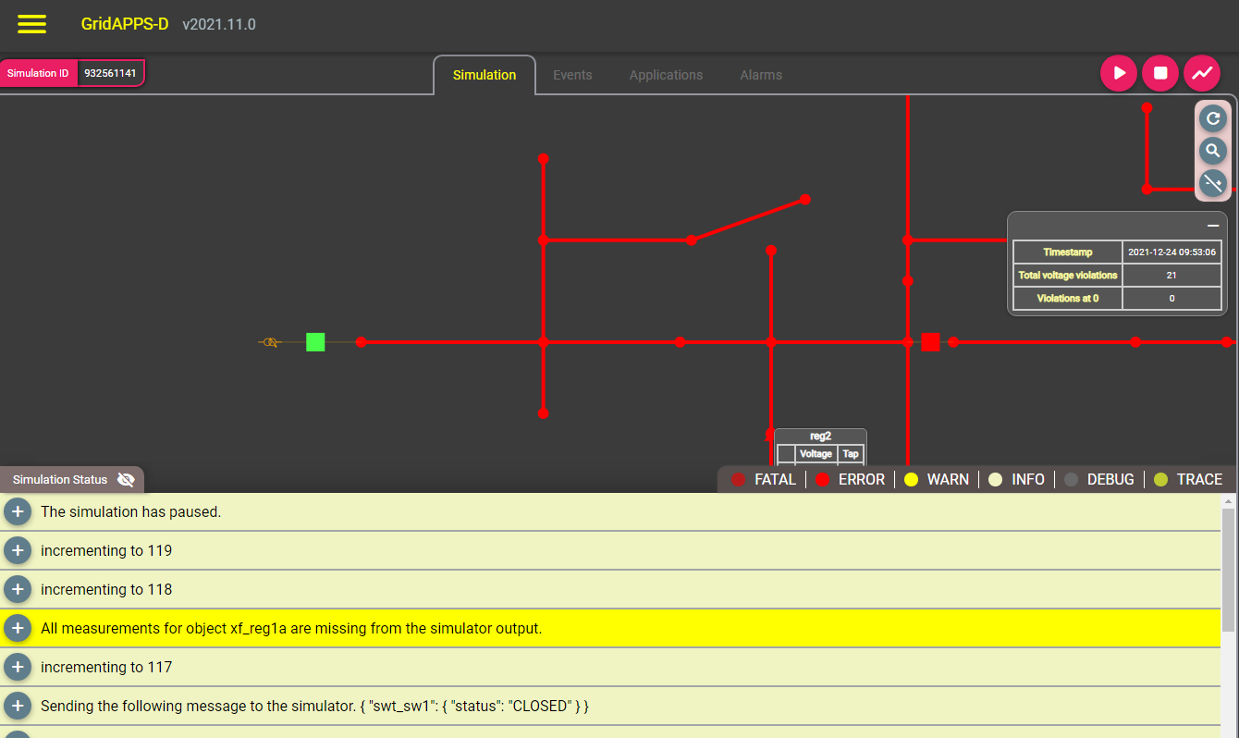
Changing switch states with inputs

